Slide 1
Data Structure Design
Composition vs Inheritance

Slide 2
Growing Our Code Base
  Implementing data structures is a fundamental part of code base development
    After a while we have the basics already in place
  Implementation changes from the basics to more refined sub-types
    Subtle changes to the existing approaches
  Why keep reinventing the wheel?
    Leverage our existing code base to make something new!

Slide 3
Techniques for Building On Existing Code
  Object-oriented programming provides two fundamental ways to implement data structures based off existing structures:
    Inheritance ("Is-A" Relationship)
    Composition ("Has-A" Relationship)
  Inheritance: Build a new, more custom version
  Composition: Wrap code around the existing version to customise it

Slide 4
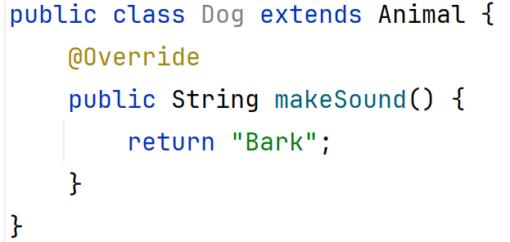
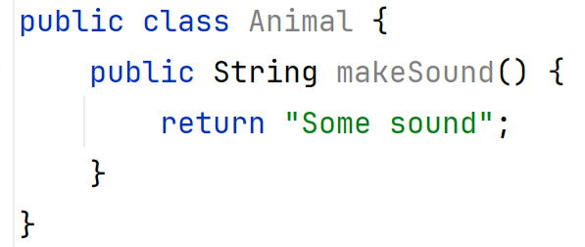
Revising Inheritance
  Inheritance allows a class to derive attributes and behaviour from another class
    Promotes code reuse
    Good for small behaviour changes
    Leads to tight coupling

Slide 5
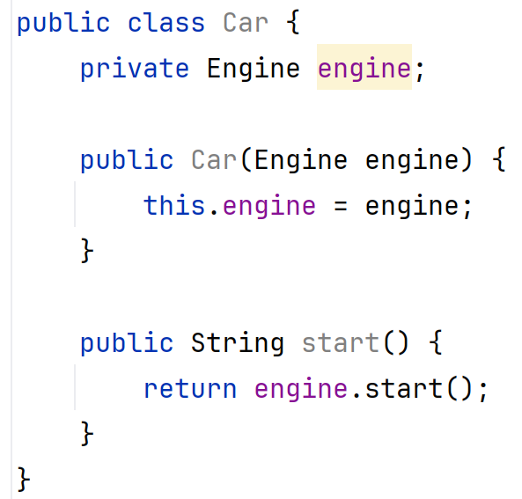
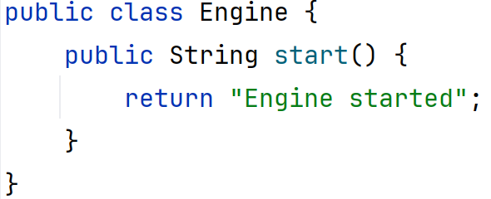
Understanding Composition
  Composition: include instances of other classes as attributes rather than extending a class
    Wraps an existing structure inside a
    new class
    Promotes loose coupling
    Allows greater flexibility

Slide 6
Comparing Inheritance and Composition
Feature | Inheritance | Composition
Code Reuse | Yes | Yes
Flexibility | Low | High
Coupling | Tight | Loose
Maintainability | Can be difficult | Easier
Use Case | When objects share a clear hierarchy | When flexibility is needed
Design principle to live by:
Favour composition over inheritance!

Slide 7
When to Use Development From Scratch
  Use when optimisation is needed
    Example: Implementing a Stack, no need for tail maintenance or many other operations
  Pros:
    Total control over implementation
    Can take advantage of direct access and custom design
  Cons:
    Requires more effort to implement and test

Slide 8
When to Use Inheritance
  Use when there is a natural hierarchical relationship.
    Example: Bird → Sparrow, Vehicle → Car.
  Pros:
    Provides code reuse
    Easy to implement for logical hierarchy
  Cons:
    Beware of deep hierarchies/inheritance trees
    Changing entities also impacts all its subclasses

Slide 9
When to Use Composition
  Use when behaviour needs to be reused across different classes.
    Example: A Car class can contain an Engine object rather than inheriting from Engine.
  Pros:
    Improves code maintainability
    Reduces dependencies.
  Cons:
    Can require more boilerplate than real code for simple relationships

Slide 10
Best Practices in Data Structure Design
  Prefer composition over inheritance
    Especially when flexibility is required!
  Use inheritance sparingly
    Only inherit when a clear "is-a" relationship exists
  Favour interfaces (and abstract classes!) to define contracts
    Try to avoid deep hierarchies unless you’re really building sub-types
  Keep it simple: Choose the approach that makes your code more maintainable and understandable
    Guideline: Favor composition for flexibility and inheritance for well-defined hierarchies.

